Slide 1
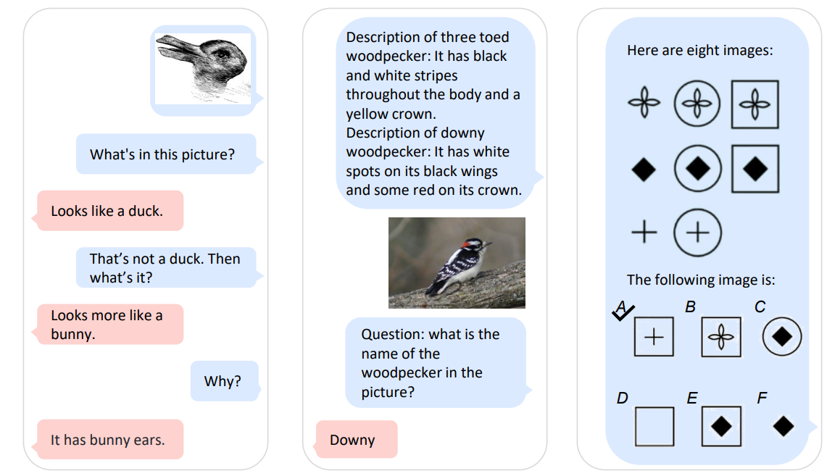
Language Is Not All You Need
Aligning Perception with Language Models

Slide 2
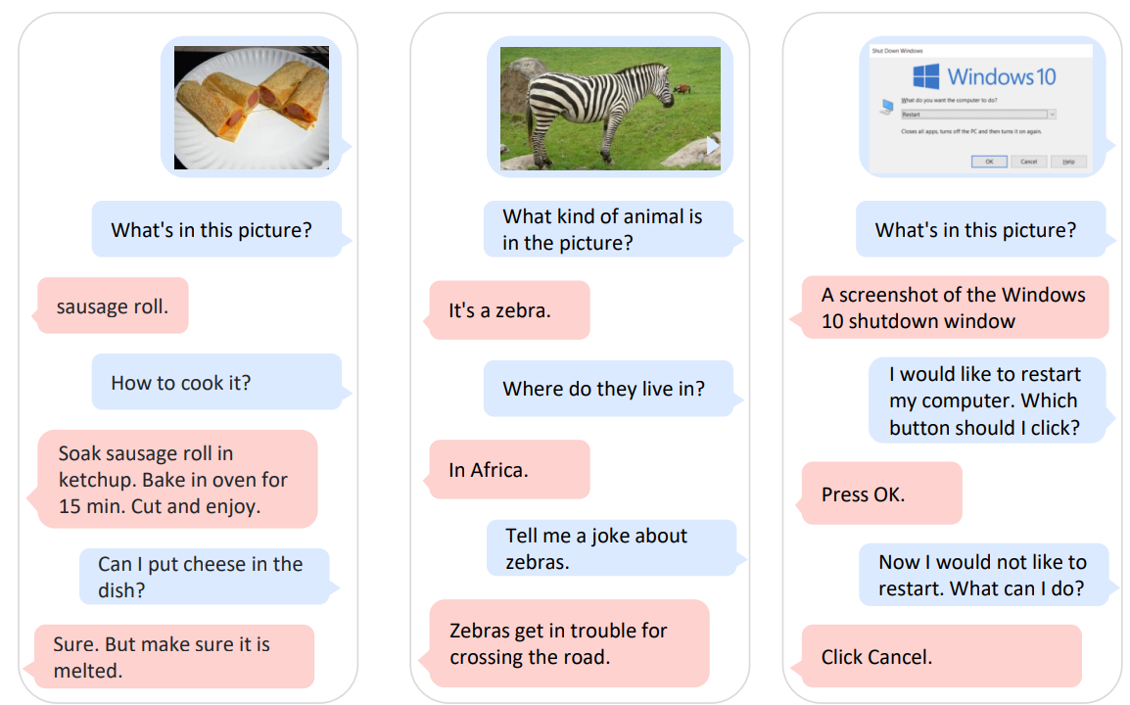
Multimodal Large Language Models
Multimodal perception is Key step toward artificial general intelligence!
MLLMs: perceive general modalities (text, image, audio…), learn in context (few-shot)
& follow instructions(zero-shot) → generate output
KOSMOS-1

Slide 3
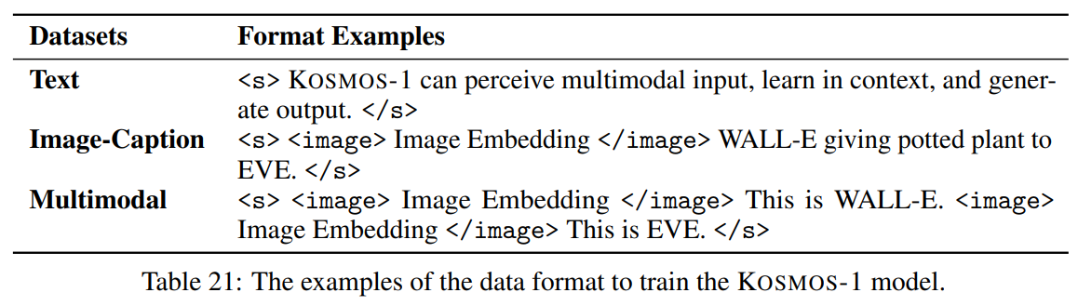
Input of KOSMOS-1
Flatten input as sequence decorated with special tokens
<s> </s>: start and end of sequence
→ Why are they necessary? (except output sequence)
<image> </image>: beginning and end of encoded image embeddings
→ model can distinguish between text and image embeddings

Slide 4
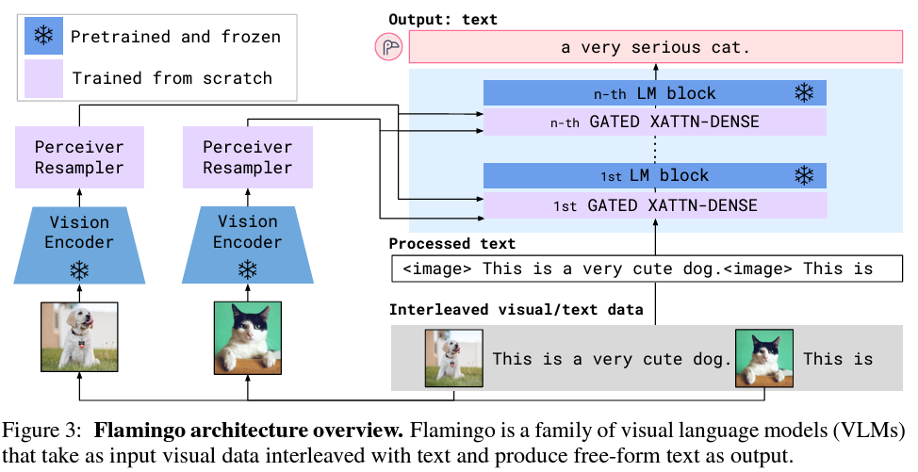
Embedding module
Encode both tokens and other input modalities(image) into vectors
Use a lookup table → map the input tokens into embeddings
Continuous signal → discrete code & regard them as “foreign languages” (BEiT)
Input image → vision encoder (Embedding module) → Resampler (Flamingo)
Produces a fixed number of visual outputs
→ computational complexity↓

Slide 5
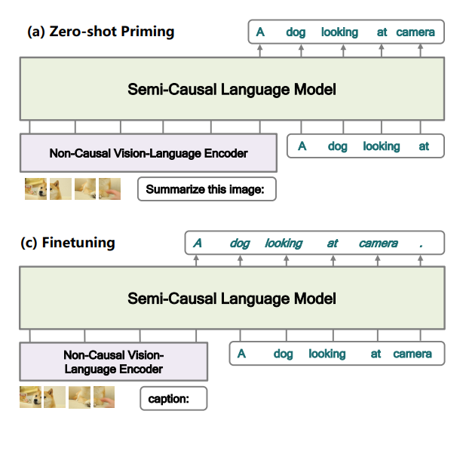
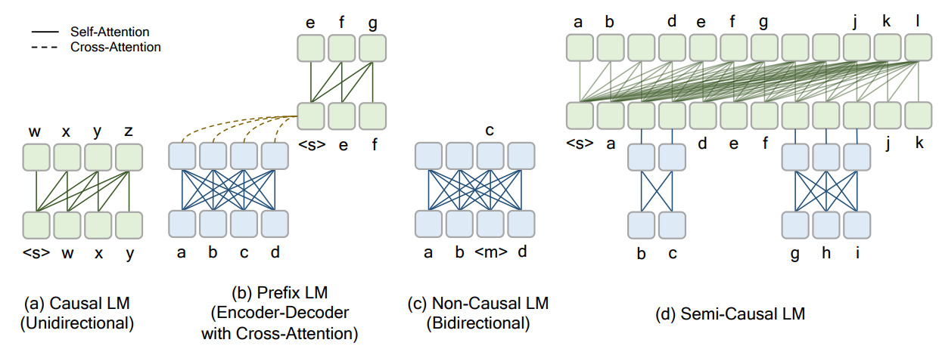
META LM
META LM: Causal, Non causal → semi-causal
KOSMOS follow META LM → employ a vision encoder as the embedding module
BUT causal model!

Slide 6
Transformer-based decoder
Embeddings of an input sequence → Transformer-based decoder
Auto-regressive manner, produces the next token by conditioning on past timesteps
causal masking → mask out future information
softmax classifier → generate tokens over the vocabulary
KOSMOS-1
in-context learning and instruction following (Language models naturally inherit)
perception is aligned with language models (training on multimodal corpora)

Slide 7
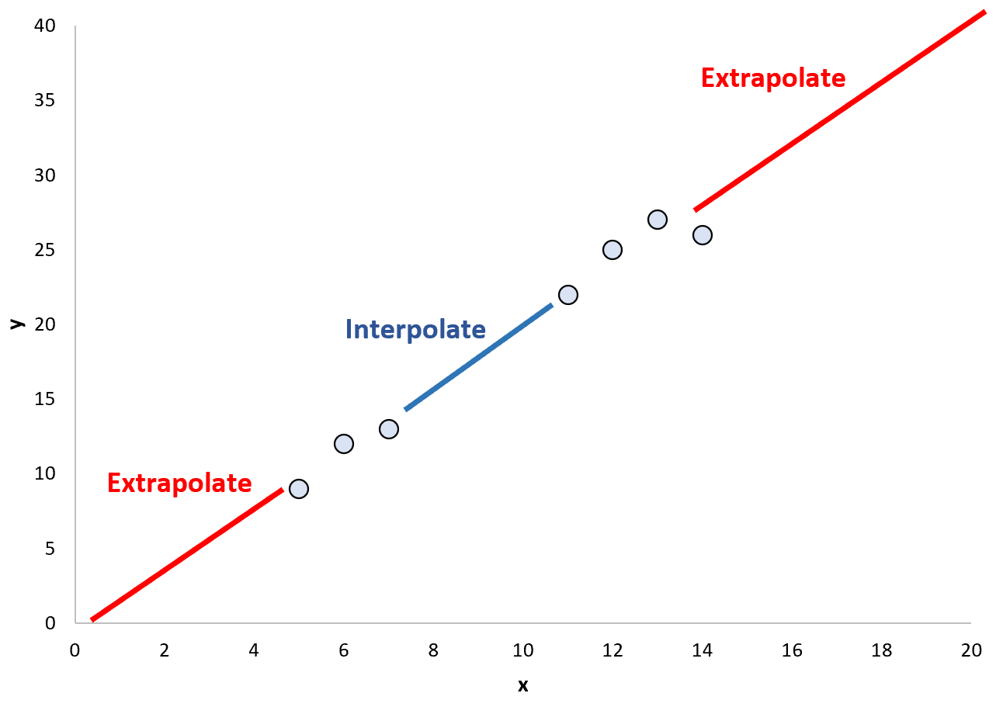
Transformer architecture
TorchScale library: designed for large scale model training, adopts Magneto as backbone
→Improve Scalability
= Improve generality, stability, and efficiency during scaling up the model size
xPos: relative position encoding for better long-context modeling
Ex) training on short while testing on longer sequences
Optimizes attention resolution → position information can be captured more precisely
Efficient and effective in both interpolation and extrapolation settings

Slide 8
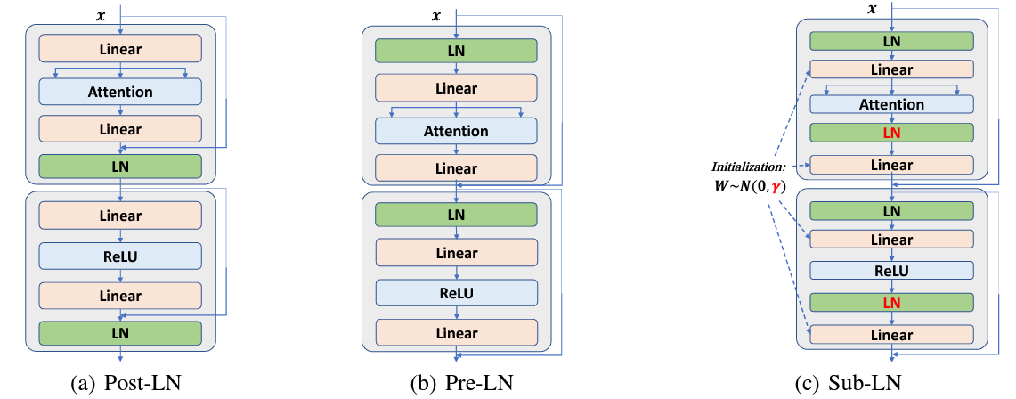
TorchScale
Library designed for large scale model training, adopts Magneto as backbone
By using extra LayerNorm to each sublayer
xPos

Slide 9
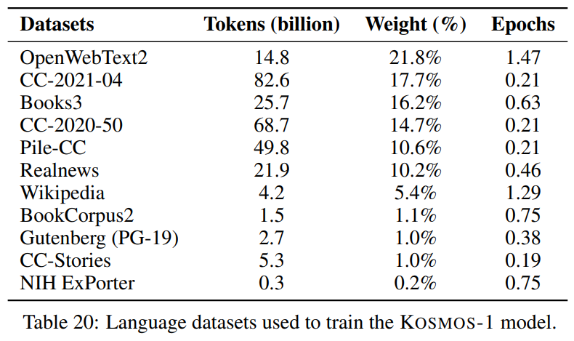
Training data
Training on web-scale multimodal corpora
1. Text Corpora: Pile, Common Crawl, RealNews datasets…
→ purged of duplicate, filtered to exclude downstream task data
2. Image-Caption pairs: LAION-2B, LAION-400M, COYO-700M…
These are made by using Common Crawl
3. Interleaved Image-Text Data: from Common Crawl
Limit number of images to 5, discard half of the documents that only have one image…
To reduce noise and redundancy & increase the diversity

Slide 10
Training Setup
24 layers with 2,048 hidden dimensions, 8,192 FFN intermediate size, and 32 attention heads
use Magneto’s initialization for optimization stability for optimization stability
Pretrained CLIP ViT-L/14 model with 1,024 feature dimensions
→ freezed except for the last layer
batch size is 1.2 million tokens (0.5 0.5 0.2), 300k steps, 375 warming-up steps
SentencePiece → tokenize the text
RoBERT → preprocess the data in the “full-sentence” format
:packs each input sequence with full sentences that are sampled continuously from one or more documents

Slide 11
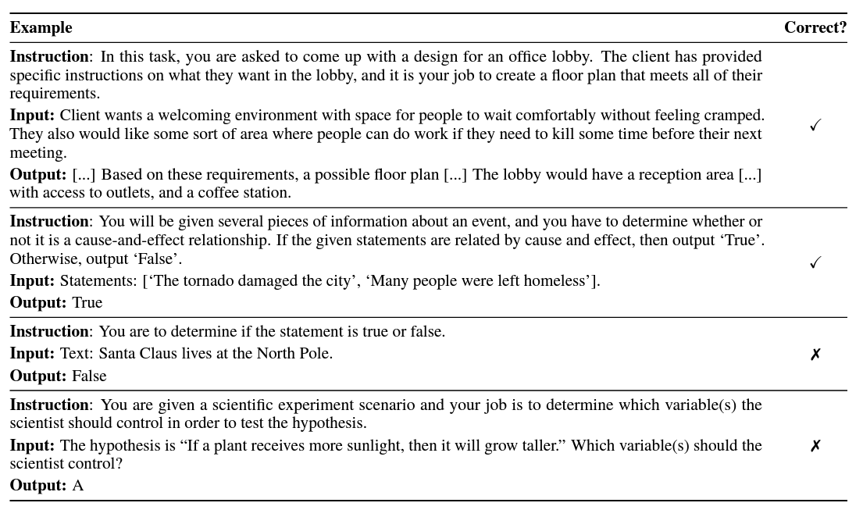
Language-Only Instruction Tuning
Presented by FLAN
Chat GPT, GPT-3… used instruction Tuning
Instruction dataset:
Unnatural Instructions: Tuning Language Models with (Almost) No Human Labor, FLANv2
instructions, inputs, and outputs
→ predict outputs
instructions and inputs loss X

Slide 12
Result
Does the model really “perceive” images?
Or just effect of the text in image caption or Interleaved data
→ Image encoder ablation study
Is MLLM better than LLM in language task?
Effect of instruction training (text only) on image recognition

